Slide 1
Team IceFyre
Пикантно Жълт Вестник

Slide 2



ORGANIZATION

Slide 3
Work Distribution
Distributed ourselves so each can do a part of the job:
Yavor – Coding.
Mina – Articles.
Asen – Design.
Nikolay – Responsiveness.

Slide 4


IDEAs

Slide 5
Considering ideas.
Initial draught of ideas.
Shy away from extreme ideas.
Shy away from complicated ideas.
Design drafts uploaded to trello.
Brainstormed when we met in person.
No really good ideas.
During second meeting decide to do a Yellow Paper-type of deal.

Slide 6
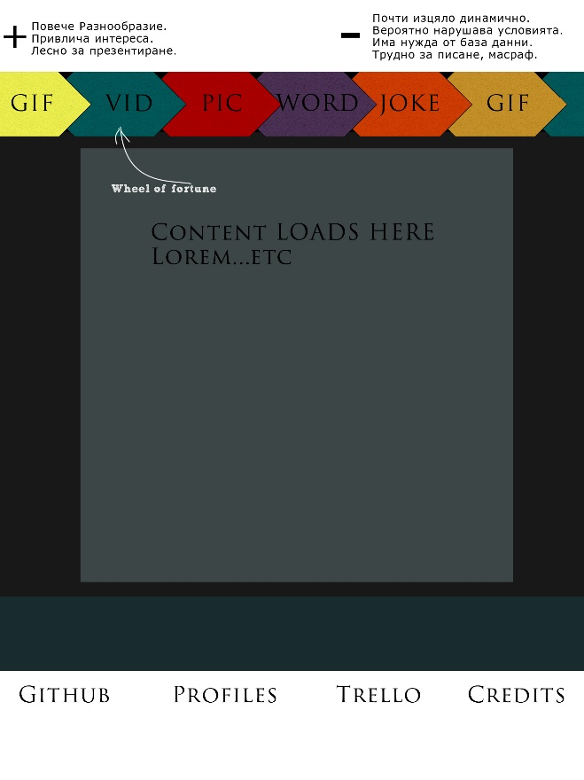
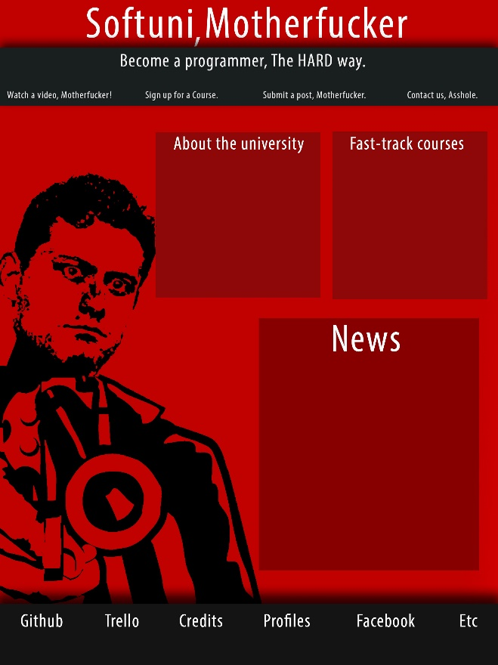
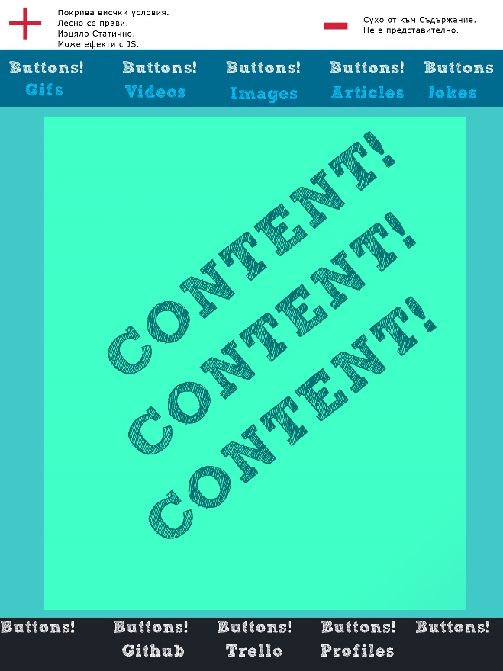
Design Drafts.
Multiple ideas about different sites. Design Drafts.

Slide 7
Workflow
Design is drafted in Photoshop
From Photoshop it’s made into HTML / CSS
From there, It’s committed to github.
After that everyone can help edit the page.
Finally, when it’s done, the page is made responsive and is then recommitted.

Slide 8
Live Demo

